Slide 1
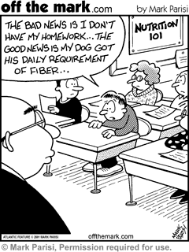
Unit One – Closer to the End
More Information for you! Yeah!

Slide 2
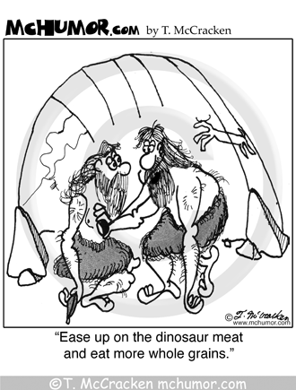
Bell-Ringer –Group Challenge
VITAMINS: WHAT DO A THERMOSTAT, A GAS PEDAL, AND A VITAMIN HAVE IN COMMON?

Slide 3
Did you get.....
They all start and regulate body functions and how the body uses its energy sources
What happens when the body takes in too many water-soluble vitamins?
They are easily excreted in the urine should more than the needed amount be present.

Slide 4
What happens when the body takes in too many fat-soluble vitamins?
Like other lipids, once they are absorbed from the intestinal tract, they can't easily be excreted. They are stored in the liver as fatty tissues and can reach toxic levels.
What is toxicity?
Toxicity is the ability of a substance to harm living organisms.

Slide 5
What was the significance of the Breakfast Lab?
Feeling Good Is Contagious: Eat an Eye-Opening Breakfast
Not only can a healthy breakfast improve your concentration, it can fast-track you closer to your healthy weight goals.
Simple carbohydrates and sugars provide a quick pick-me-up. Thus, the subsequent crash. When your morning energy spike turns into an energy slump, ask yourself, “Am I choosing the right foods?” If high-fibre items are not on the menu, you’ve got your answer.
Fibre is the smart way to fuel up for your day.
Moral of the story: There's a reason they say breakfast is your most important meal of the day. Think twice about it and double your efforts to get the 20-35 grams of fibre you need a day (for context, a cup of quinoa is 8 grams, a pear provides 5 grams, and a cup of navy beans gives you 19 grams). It's your job to make sure you get there and show others why it's worth doing it too.

Slide 6
Myth: Fat makes you fat
Truth: It's true and false. While fat itself doesn't create fat, Fat, whether it's margarine, olive oil, or butter, is a concentrated source of calories. If you eat a lot of fat in your diet, you're going to consume a lot of calories, and yes, that can make you gain weight.
Before you axe fat from your diet, note that all fats aren't bad. Unsaturated fats, as well as omega-3 fatty acids, are essential for optimum health, and omega-3 fatty acids have been shown to lower the risk of heart disease and stroke. Health Canada recommends adults get 20-30 per cent of their daily calories from healthy fats.

Slide 7
Myth: Carbs make you fat
Truth: Brownie lovers can breathe a sigh of relief, for this myth is false. This is the same principle as the fat question; if you eat more than you need, whether it's fat, carbohydrates, protein, you'll store those extra calories as body fat, period.

Slide 8
Myth: Diet pop is healthier than regular pop
Truth: Diet pop isn't healthier than regular pop, but does have a slight nutritional advantage. If you have to drink pop it's better to drink diet pop, because you're not getting the 10 teaspoons of sugar that come in a regular can. However the phosphoric acid in all colas can negatively affect bone density. Recent studies have also suggested that canned pop can have traces of Bisphenol A, so drink at your own risk.

Slide 9
Food Microbiology and Food borne Illness
Bacteria, yeasts, and mould are microorganisms associated with foods.
Microorganisms may be classified into three groups according to their activity:
Beneficial microorganisms may be used in the process of making new foods. Cheese is made with microorganisms which convert the milk sugar to an acid.
Spoilage microorganisms cause food to spoil and are not harmful to humans. A spoilage microorganism is responsible for souring milk.
Pathogenic microorganisms are disease-causing microorganisms. The living microorganism or a toxin (microbial waste product) must be consumed to cause symptoms associated with specific pathogenic microorganisms.

Slide 10
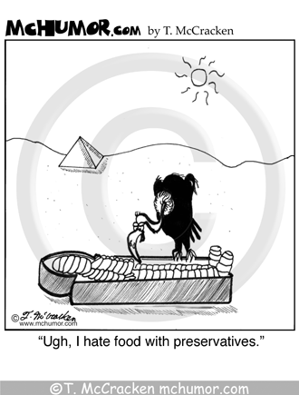
Overview of Food Allergies and Sensitivities
Food allergies and food intolerances are two common classes of food sensitivities.
The "Big 8" Trouble Foods
Peanuts, soybeans, fish, crustaceans, milk, eggs, tree nuts, and wheat are considered the most common allergenic foods on a worldwide basis.
Quiz Time.....☺
My friend is lactose intolerant. If she
Comes over for Dinner, do I have to
make a milk-free meal?
True or False

Slide 11
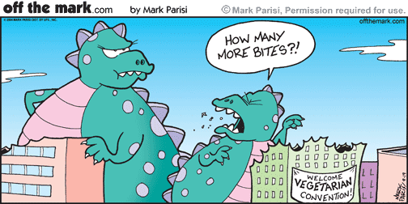
False! Most people with an intolerance can still consume milk products.
Canada’s Food Guide is not intended for:
a. Babies from 0-12 months
b. Children from age 2-12 years
c. Teenagers and Adults
d. Vegetarians
e. Certain Cultural Groups

Slide 12
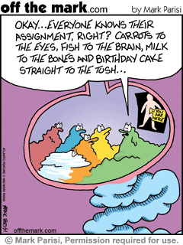
A is the answer!!!
The Canadian Food Guide is designed for Canadians over 2 years old!
Who is at greatest risk for a food allergy?
a. A child whose parents both have allergies
b. A child who’s mother ate a lot of peanut butter during pregnancy
c. Someone who lives in a very polluted neighbourhood
d. A child with a father with allergies

Slide 13
A. The risk for developing allergies is greatest when both parents have an allergy.
Symptoms of an allergic reaction vary from one individual to another. Symptoms may include one or more of the following;
Tingling sensation in the mouth
Swelling of the tongue, throat, eyes, face and lips
Difficulty breathing
Hives or a rash
Vomiting
Abdominal cramps
Diarrhea
Drop in blood pressure
Loss of consciousness
In severe cases, an allergic reaction can cause death.
Allergy symptoms typically appear within minutes or up to two hours after the allergy-causing food has been consumed.

