Slide 1
Starting Out!
Individual and Family Living in Canada
Mrs. Standish-Lewis

Slide 2
Important Terms
Write these out in your notes. Start a glossary page in your notes.
Anthropology
Data
Economics
Facts
Opinions
Psychology
Research Questions
Sociology
Social Sciences

Slide 3
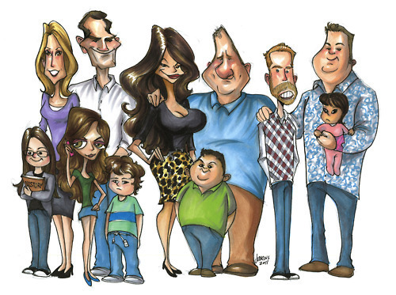
Modern Family
Exploring different types of families

Slide 4
YOU
Create a Mind Map in your notes.....
What is important to you?
What do you look like?
What are the challenges in your life?
What do you think about?
What is your pet peeve?
Who are the important people in your life?
What can you do well?
What do you like to do?
How do you spend your money?
How do you feel?

Slide 5
Why study the family?
Experience and knowledge.
You will probably form a family some day.
Help with personal life, if you choose to volunteer or work professionally with families in the future.

Slide 6
What are the Social Sciences?
Social Sciences: Study human behaviour.
  Psychology: examines how you think, how you feel, and what motivates you.
  Sociology: studies how people behave with others within families, groups and society.
  Anthropology: studies humans and their cultures.
  Economics: studies the production and distribution of wealth.

Slide 7
Social Science Research
Looks for patterns in human behaviour as well as the connections among behaviours.
Results are often expressed as percentages or ratios. Ex: 85% of teenagers identify their friendships as very important in their lives
Better able to distinguish between personal opinions and facts
  Opinions: are based on individual observations or beliefs
  Facts: supported by evidence that everyone can observe.

Slide 8
Social Science Research Method
Identify the problem
Formulate a research question
Gather data
Analyse the data
Form and communicate conclusions

Slide 9
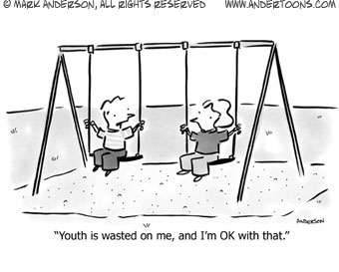
Social Sciences

Slide 10
Check Point Questions
What are the disciplines that contribute to social science?
What is the focus of each of the disciplines?
What are the reasons for family studies?
What are the steps in the social science research method?

Slide 11
This is Me!!
Use a photograph of yourself and use it as the foundation of a collage entitled, “This is me!”
Use words, images, artifacts around the photograph to represent you as you are today.
Include ideas about what you look like, how you feel, what you think about....etc.
We are going to post these in the class!

