Slide 1
Relationships and Communication
Evaluation Questions

Slide 2
Describe the differences between childish and mature styles of communication.
Style of a child:
Whining
Name Calling
Yelling
Ordering
Verbal Abuse
Throwing Tantrums
Acting out of control
Not Listening
Interrupting

Slide 3
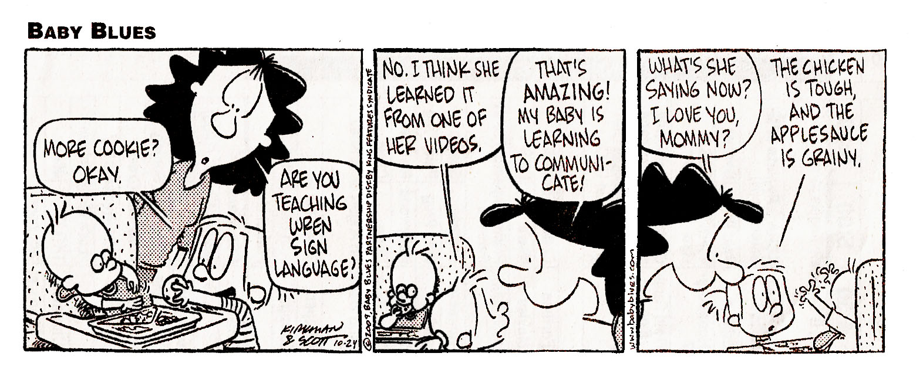

Slide 4
Style of a Parent:
Directing
Demanding
Punishing
Ordering

Slide 5
Style of An Adult:
2-way communication
Remaining calm
Showing respect
Displaying win-win attitude
Trusting

Slide 6
Which style works most effectively?
Adult to Adult
Why?
  Everyone remains calm and uses good communication techniques

Slide 7
Transactional Analysis is:
Three styles of communicating:
  Child, parent, adult

Slide 8
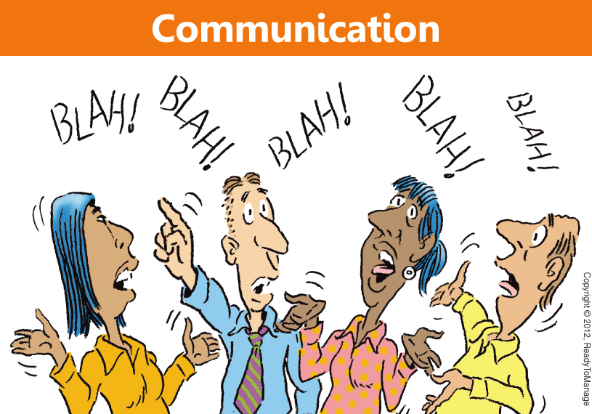

Slide 9
What is the lowest level of communication?
Child Style
Easiest level in which to communicate, easy to go back to child-like behaviour; don’t have to think

Slide 10
What is the highest level of communication?
Adult Style
Hardest level in which to communicate, takes more effort to think about how to say things

Slide 11
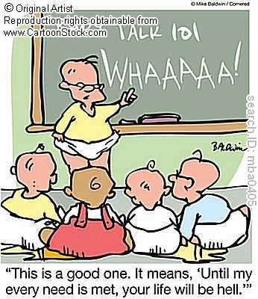
What effect does communicating in the style of a child have on the person being communicated with?
He/She reverts to using the parent or child styles him/herself.

Slide 12
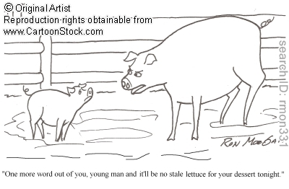
What effect does communicating in the style of a parent have on the person being communicated with?
Produces rebellion and other negative feelings

Slide 13
What effect does communication in the style of an adult have on the person being communicated with?
Calms him/her;
Creates an atmosphere of respect and trust;
A win-win attitude, lets everyone feel good

Slide 14
Describe three positive ways to resolve conflicts.
Don’t attempt to settle the dispute at scene of the crime
Don’t bring up the past
Define the problem briefly
Look for solutions together
Each work toward the solution chosen

Slide 15
Describe three negative ways to resolve conflicts:
Name Calling
Sidetracking
Losing your cool
Using “you” statements

Slide 16
Four major steps in resolving conflicts are:
1. Define the problem
2. Verbally summarize the feelings for clarification
3. Look for solutions
4. End with an expression of love

Slide 17
Discussion Questions
How do you blow off steam? Make a list of healthy ways people can let go of anger.
Anger can be very overwhelming at times. Why is it so important to express your anger about a situation? What can happen if you don’t?
Many people believe that violent TV shows and movies can influence how people handle their own problems. Do you think this is true? What role do the media play in how we deal with our problems?

Slide 18
Three major styles of communication:
Passive – Allows you to be run over
Assertive (Most Effective)
Aggressive – “runs over” other people

Slide 19
Extension Activities:
Design a billboard that promotes nonviolent ways to resolve conflicts. Remember that many people see a billboard for only a few seconds, so choose words and images that will make an impression!
Think about how you handle your anger and communicate your feelings now. What works for you? How could you deal with your anger and problems more constructively? Make a list of ways you can improve in this area.
Imagine you are a famous pacifist from history such as Martin Luther King, Jr., Mother Teresa, Gandhi, or John Lennon. Write an editorial from this person’s perspective that describes his or her thoughts about how our society handles its conflicts as a whole. What suggestions would this person make to guide us in the future?

