Slide 1
HSP3M
Day Two and Three
"Though no-one can go back and make a new start anyone can start now and make a new ending"

Slide 2
Intro Review
Social sciences were recently discovered
Began to be studied because of age of development
Since sciences are used to study laws of nature, they can be used to study laws of human nature
Practical observations

Slide 3
Why Study Social Sciences?
vital for future of society
after studied you are more able to make a difference
framework in which people live their lives

Slide 4
What can I do with it?
media
advertising/marketing
business management
local government
international organization
education
news analyst
counselors/social workers etc.

Slide 5
What Makes Us Human?
Scientists have studied evidence for a long time to develop a theory of human evolution
Study of evolution needed years of examination that built on the research of various scientists
The theory has evolved over time and revolutionized the way we consider ourselves to be different

Slide 6
WHAT MAKES US HUMAN?
What does being human mean to you?
What distinguishes humans from animals?
Jot down your thoughts in your notebook
Share with the class

Slide 7
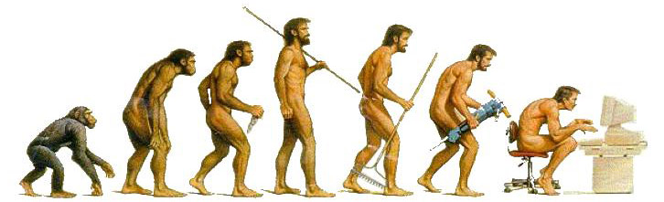
WHAT MAKES US HUMAN?
Over the next few days we will be looking at
how anthropology, psychology and sociology define humanity.

Slide 8
The Anthropological Answer
WHAT MAKES US HUMAN
Anthropologists use human biological
evolution to answer the question of what
makes humans different from animals
They use fossils, cultural remains and the
study of DNA as evidence supporting the
development of humanity.

Slide 9
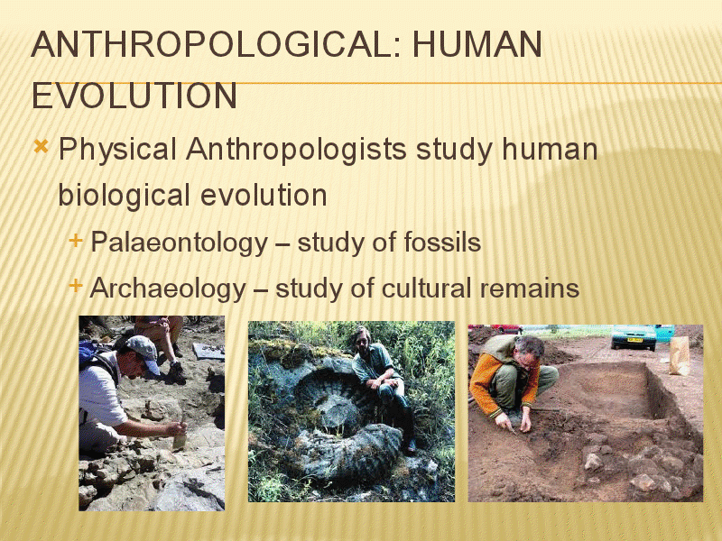

Slide 10
Anthropology is divided into two groups:
PHYSICAL | CULTURAL
This area studies how human beings have adapted biologically over time, as well as examining humans relationships in regards to other things/other species Much of the physical anthropology is found in fossils and bones. | This is the study of human behaviour in which different societies and cultures are compared Three main areas of cultural anthropology are: Archaeology (think Indiana Jones!) Linguistic Anthropology (study of language) Ethnology (study of tribes)

Slide 11
Who Was Charles Darwin?
-scientist from wealthy family
-left for a 5 year voyage when he was 22 to study nature
-recorded information about the interaction of animals in his journal
-journal was his only proof, so people were skeptical
-wrote book "origin of species" which was controversial because it went against what the dominant religion (catholic) church; specifically genesis

Slide 12
The Psychological Answer
The Cognitive Process
-interpreting and manipulating mental images to obtain information to reason and to solve problems
-the central ability of humans that defines who we are
Left Side Vs. Right Side of the Brain
-this theory of the structure and functions of the mind says that the two different sides of the brain control two modes of thinking
-left side: logical, sequential, rational, analytical, objective, looks at parts
-right side: random, intuitive, holistic, synthesizing, subjectivce, looks at wholes

Slide 13
The Cognitive Process
-it if human thinking and reasoning that makes us unique
-we try to rearrange information in new forms that allows us to answer questions or solve problems (applying learned concept to new ideas)
-we also manipulate what we know into categorie/concepts
Reasoning
-deductive reasoning: applying general assumptions to specific cases eg: all humans have brains-sonia is a human-sonia has a brain
-inductive reasoning: collecting specific information to form a general assumption eg: most men enjoy sports-Geuff is a man-therefore geoff enjoys sports
When Faced With a Problem Humans Generate Solutions
Strategies for finding solutions: trial and error, long term emory, working backwards from your goal, dividing the problem into parts, using insight to make comparisons

Slide 14
There are 4 main fields of psychology:
  Experimental Psychologist: conducts experiments in a controlled setting (laboratories) examining what motivates humans/animals and how they learn
  Developmental Psychologist: focuses on how people grow, mature, and age
  Social Psychologist: the study of how a person’s behaviour is influenced by groups
  Applied/Clinical Psychologist: utilizes his/her training in psychology to help people and organisations. Examples include a psychiatrist, psychologist, and a social worker.

Slide 15
The Sociological Answer
Culture: refers to human activity and the symbolic structures that give such activities significance and importance
Symbol: something or someone that represents something else, such as an idea, quality or condition
-sociologists define humanity by its ability to attach itself emotionally to symbols and cultural ideals
-how a society is recognized or remembered is usually tied to a symbol
-these symbols most often come to embody concept of heritage, history, nationalism and pride
What About The Animals?
-while animals demonstrate some evidence of culture (like we discussed in the "what makes us different article") there is little evidence that animals relate to these elements of their lives
-it is purely instinctual or genetically programmed
-humans, on the other hand, live in socially constructed societies and are defined by their concepts of culture

Slide 16
Human Interaction and Culture
-the primary study of sociologists is how culture defines/regulates humanity
-''culture'' embodies who we are, how we live and how we behave
-it includes ''codes of behaviour'' that manages our social interactions, dress, language, religion and rituals
-specific to our species are the codes that explain past and present experiences as well as predictions for the future
-our society has ways and codes that define values and norms
Values:
standards of what is considered right and wrong
socially constructed, these views regulate how people live
values are considered to be subjective and vary between people and culture
Examples: material and comfort, wealth, honour, religiosity

Slide 17
Norms:
rules that indicate what people should do or how they should act
related to values but tend to be more specific
norms are rules for behaviour in specific situations, while values identify what should be judged as good or bad
Evolving Culture
-culture is a product of human interaction and evolution
-it is constantly changing and adapting as a result of technology innovations and inventions, contact with other cultures, medical advancements, and new knowledge

Slide 18
Sociologists are interested in areas such as:
gender roles (sexism)
stereotyping (racism)
crime rates
poverty
peer pressure
the role of individual in various groups (peer, family, school, work, city)

Slide 19
What exactly is a Human?
It is a B.O.S.S. with a big brain that needs to be bossed around for a long time.
BIPEDALISM: frees up our hands to do other things…
OPPOSABLE THUMBS: we can make and use precise tools…
STEREOSCOPIC VISION: we can see in 3D, 180 degrees.
SPEECH: we communicate complex ideas and create lasting, transferable cultural knowledge

Slide 20
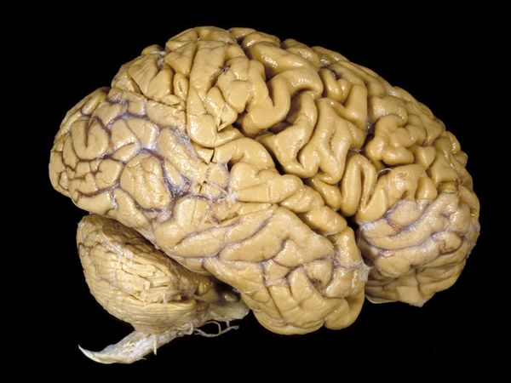
We have a big, highly organized BRAIN that can think in abstract terms and has…
  a complex awareness of past and future
  developed a wide range of cultures
  developed writing **to pass knowledge from one generation to the next**

Slide 21
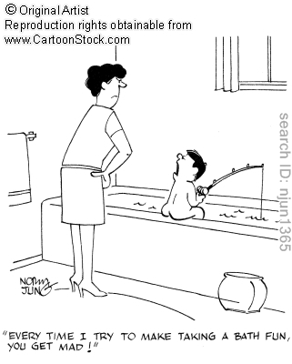
We need to be BOSSED AROUND for a long time:
  We are dependent on others for the first 18-20 years of our lives
  This period allows us to be socialized: i.e. to learn all the rules, expected behaviors of our complicated, technological culture

